Slide 1
Solving ANY Logical Problem
Assign each boolean possibility a variable
Draw out a truth table
Simplify with a Karnaugh Map
Construct the software condition or hardware circuit

Slide 2

Missile Control
The Google campus has gained missile defense capability governed by its Security Council. The Council consists of four members: the CEO and three Counselors (CFO, CTO, Public Relations). The missile system is to be activated by a device obeying these rules: each member of the Security Council has a button to push; the missiles fire only if the CEO and at least one Counselor push their buttons. Design the rocket firing circuitry.

Slide 3
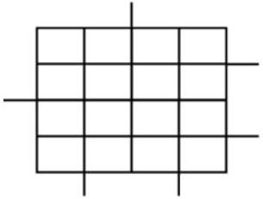
Karnaugh – The Maps

Slide 4
Karnaugh – The Rules
Draw Rectangles!
Rules:
  Rectangle must surround a number of squares that is a power of 2 (1, 2, 4, 8, etc)
  Bigger rectangles are better rectangles
  All 1’s (or T’s) must ultimately be accounted for
  Rectangles can wrap around from one side of the map to the other!

Slide 5
Try this!
Redesign the example problem so that the missiles will fire even when the CEO doesn’t press the button if all three counselors do.
Redesign the example problem so that the missiles will fire only if the CEO presses the button and at least two of the counselors do.
Redesign the example problem so that there are only the CEO and two counselors, but the missiles will fire if at least two (any two) members agree to fire.

